Slide 1



A CENTER FOR INTER-DISCIPLINARY RESEARCH
2021-22
TITLE
“SMART TREADMILL”
SUPERVISED BY
SAI CHARAN & LAKSHMI PRIYA
GOKARAJU RANGARAJU
INSTITUTE OF ENGINEERING AND TECHNOLOGY
AUTONOMOUS

Slide 2
Advanced Academic Center
( A Center For Inter-Disciplinary Research )
This is to certify that the project titled
“SMART TREADMILL”
is a bonafide work carried out by the following students in partial fulfilment of the requirements for Advanced Academic Center intern, submitted to the chair, AAC during the academic year 2021-22.
NME | ROLL NO. | BRANCH
MOHAMMED ABDUR RAHMAN |  | IT
BETHI VISHNU VARDHAN REDDY | 19241A05U5 | CSE
CHEVVURI SWARNA TEJASWI | 19241A04D1 | ECE
NAME | ROLL NO. | BRANCH
MOHAMMED ABDUR RAHMAN | 21241A0431 | ECE-A
JANAGAM RUTHVIK | 21241A0421 | ECE-A
MANEPALLI JOSHI ABHIRAM | 21241A0499 | ECE-A

Slide 3
NAME | ROLL N0 | BRANCH
GOPIDI CHANDANA | 21241A12E9 | IT
MEGHANA RANGAVARAJULA | 21241A0431 | ECE
This work was not submitted or published earlier for any study
Dr/Ms./Mr.
Dr.B.R.K.Reddy
Program Coordinator
Dr. G. Ramesh
Dean, AAC
Project Supervisor

Slide 4
ACKNOWLEDGEMENTS
We express our deep sense of gratitude to our respected Director, Gokaraju Rangaraju Institute of Engineering and Technology, for the valuable guidance and for permitting us to carry out this project.
With immense pleasure, we extend our appreciation to our respected Principal, for permitting us to carry out this project.
We are thankful to the Associate Dean, Advanced Academic Centre, for providing us an appropriate environment required for the project completion.
We are grateful to our project supervisor who spared valuable time to influence us with their novel insights.
We are indebted to all the above mentioned people without whom we would not have concluded the project.

Slide 5
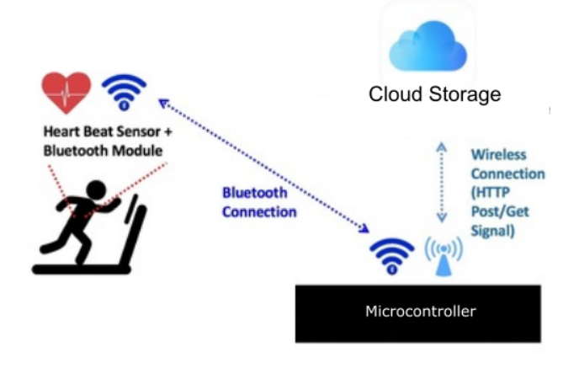
ABSTRACT
The concepts of IoT are applied to a commonly used device, a treadmill. The main
objective is to enhance the workout experience by adaptively modulating the speed
of the treadmill based on the user’s heart rate.
It allows a user to experience a hassle free workout where they don't have to worry
about modulating the treadmill's speed as the workout progresses.
Additionally, the analysis provided at the end of each workout would help the user
improve their achievements and work towards their fitness goals in a more
systematic manner.
The microcontroller collects and stores the heart rate data from the heart rate sensor on
its database. The user data is updated every second. As the user starts running, the
database is populated with the heart rate.
With the input, the microcontroller communicates with the DC Motor and
modulates the speed of the treadmill based on the heart rate of the user.

Slide 6
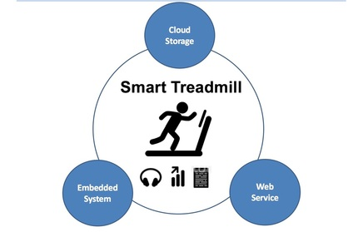
INTRODUCTION
The concept of smart systems and homes has given way to a world where we can connect anything to the Internet and program household devices such that they are responsive to sensors in their environment.
​Building on the scalability of smart homes and the Internet of Things that allows almost any device to expand its utility this way, we plan to build a Smart Treadmill that can adjust it's speed based on real-time information of the users heart rate and simultaneously stream a playlist conducive to the users workout routine.
We are currently experiencing a shift from the Information Age to the Intelligence Age which will be characterised by the autonomous communication between intelligent devices that are sensitive to the presence of a person and responds by performing a specific task that enhances that person’s lifestyle. The shift is driven by the consumer’s desire for efficiency, particularly in connection with everyday tasks that can be easily automated.
To this end, we have applied the concepts of IoT to a commonly used device, a treadmill. Our main objective is to enhance the workout experience by adaptively modulating the speed of the treadmill and streaming a playlist of songs based on the user’s heart rate.
We have applied the concepts of IoT to a commonly used device, a treadmill. Our main objective is to enhance the workout experience by adaptively modulating the speed of the treadmill and streaming a playlist of songs based on the user’s heart rate.
​

Slide 7
CODE
#include <AFMotor.h>
AF_DCMotor motor1(4);
AF_DCMotor motor2(3);
int i,x,speed=0,f=20;
int pulserate=70;
void setup()
{
Serial.begin(9600);
motor1.setSpeed(200);
motor2.setSpeed(200);
}
void loop()
{
for(i=0;i<255;i++)
{
motor1.setSpeed(i);
motor2.setSpeed(i);
motor1.run(FORWARD);
motor2.run(BACKWARD);
delay(10);
}
delay(10000); //10sec delay
/*
//For back
for(i=255;i>0;i--)
{
motor1.setSpeed(i);
motor2.setSpeed(i);
motor1.run(BACKWARD);
motor2.run(FORWARD);
delay(10);
}
*/
/

Slide 8
CODE
/virtually increasing pluserate till 140
for(pulserate=70;pulserate<140;pulserate++)
{
Serial.println("Pulserate: ");
Serial.println(pulserate);
Serial.println("Speed");
…
[3:30 pm, 21/10/2022] Abdur Rahman: #include <AFMotor.h>
AF_DCMotor motor1(4);
AF_DCMotor motor2(3);
int i,x,speed=0,f=20;
int pulserate=70;
void setup()
{
Serial.begin(9600);
motor1.setSpeed(200);
motor2.setSpeed(200);
}
void loop()
{
for(i=0;i<255;i++)
{
motor1.setSpeed(i);
motor2.setSpeed(i);
motor1.run(FORWARD);
motor2.run(BACKWARD);
delay(10);
}
delay(10000); //10sec delay
/*

Slide 9
CODE
//For back
for(i=255;i>0;i--)
{
motor1.setSpeed(i);
motor2.setSpeed(i);
motor1.run(BACKWARD);
motor2.run(FORWARD);
delay(10);
}
*/
//virtually increasing pluserate till 140
for(pulserate=70;pulserate<140;pulserate++)
{
Serial.println("Pulserate: ");
Serial.println(pulserate);
Serial.println("Speed ");
Serial.println(f);
f=f+1;
if(f==40)
{
while(pulserate>70)
{
Serial.println("Pulserate: ");
Serial.println(pulserate);
pulserate--;
Serial.println("Speed ");
Serial.println(f);
f--;
delay(1000)
}
}
delay(2000);
}
}

Slide 10
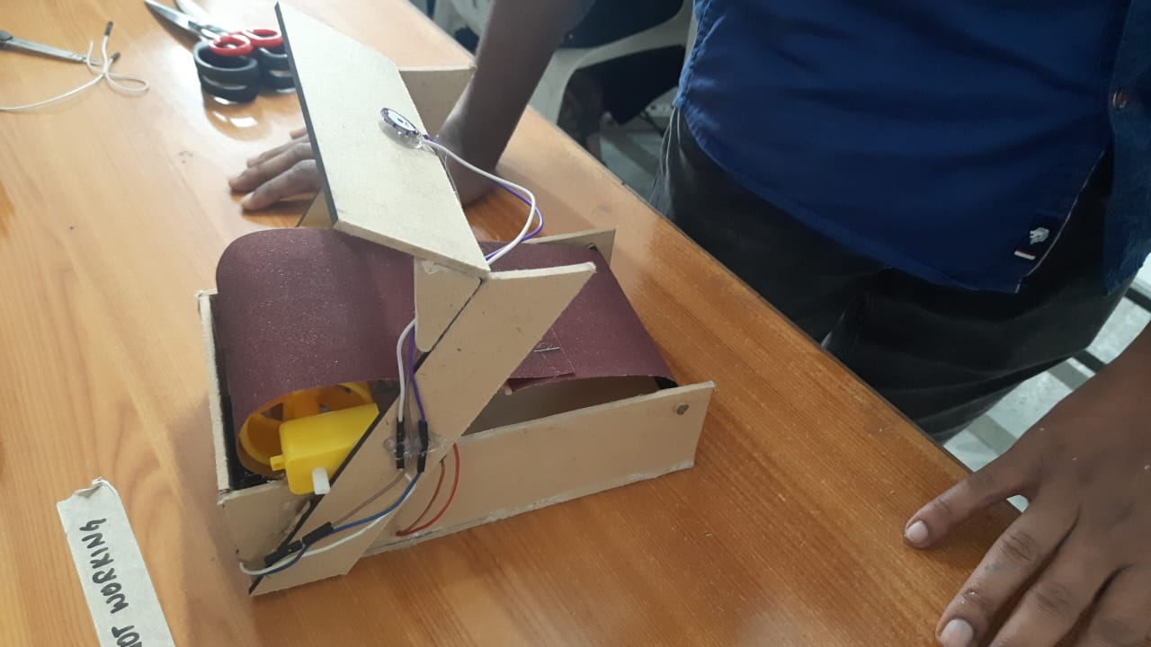
IMAGES

Slide 11


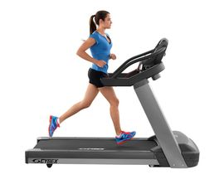
FUTURE DEVELOPMENTS
Mobile App support
The project can be extended to provide the user with a mobile application that provides the user with workout information and suggests workout plans depending on the users goals
Play Music via Bluetooth.
We can connect the Pi to a Bluetooth Module so that music can be played wirelessly through any Bluetooth enabled device such as wireless headphones.
Integrate with a Treadmill
Finally, this project can be realised physically using an actual treadmill in order to provide a cheap and affordable means for users to have more control over their workout regimes.

Slide 12
REFERENCES
https://issuu.com/ijtetjournal/docs/icicce0191
https://www.researchgate.net/publication/311912500_An_Embedded_System_for_Monitoring_Pulse_Rate_during_Indoor_Exercise?enrichId=rgreq-95229d7b6ef1d5d158a1252f17daafd5-XXX&enrichSource=Y292ZXJQYWdlOzMxMTkxMjUwMDtBUzo0NDM4MTU0NTU2NjIwODBAMTQ4MjgyNTI1ODcwMw%3D%3D&el=1_x_3&_esc=publicationCoverPdf
https://smarttreadmill.weebly.com/
http://blog.initialstate.com/raspberry-pi-heart-rate-sensor/ https://learn.adafruit.com/downloads/pdf/adafruits-raspberry-pi-lesson-8-using-a-servo-motor.pdf
http://www.element14.com/community/groups/internet-of-things/blog/2014/07/02/iot-alarm-clock--part-4
http://www.johannesbader.ch/2014/06/track-your-heartrate-on-raspberry-pi-with-ant/
https://learn.adafruit.com/adafruit-dc-and-stepper-motor-hat-for-raspberry-pi/using-dc-motors
https://en.wikipedia.org/wiki/Internet_of_Things
http://iofthings.org/intelligence-age/
https://pymotw.com/2/time/
http://www.tutorialspoint.com/python/python_multithreading.htm

